Slide 1
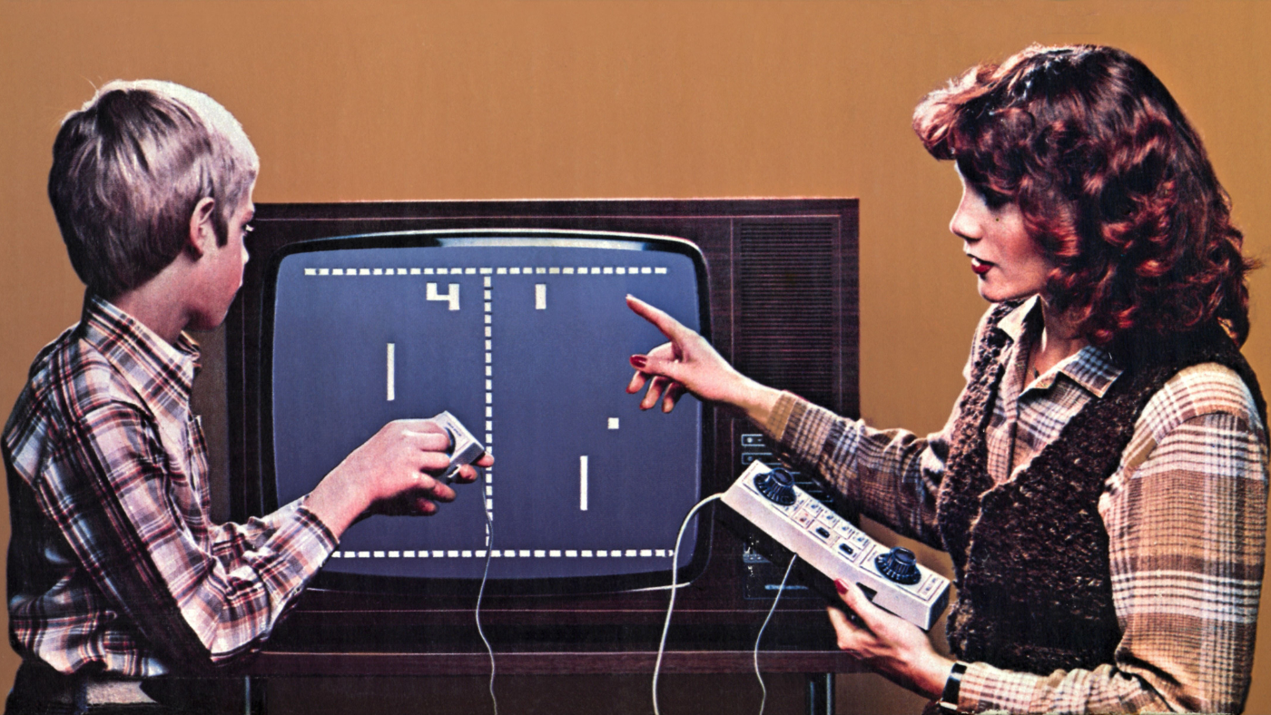
Notes:
Are you tired of playing pong on your old dust boxy tv? Isn’t getting boring for you?

Slide 2
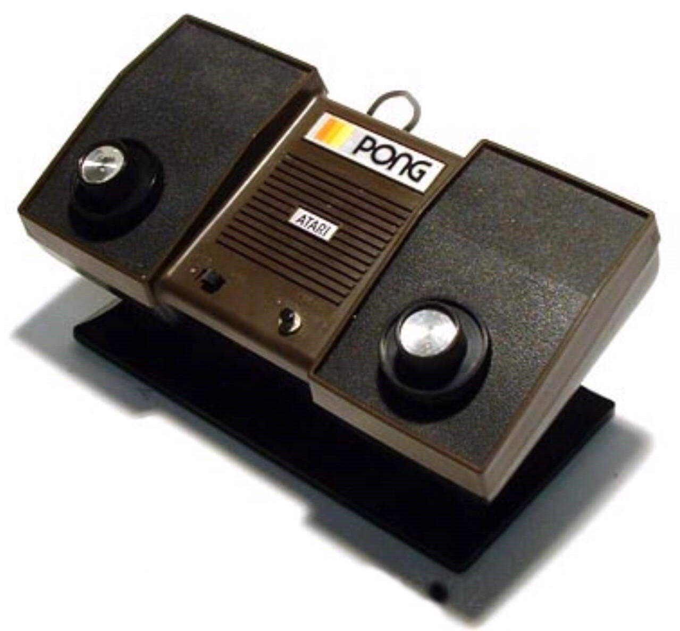
Notes:
Wouldn’t you want to upgrade from this ancient atari

Slide 3
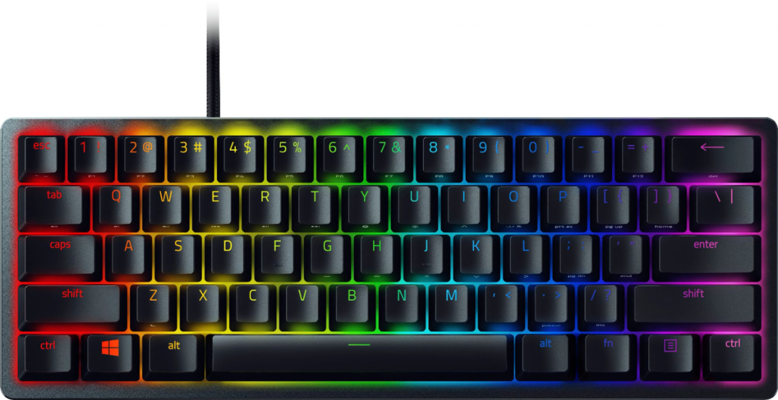
Notes:
and play the game of pong on a fancy new keyboard like this?

Slide 4
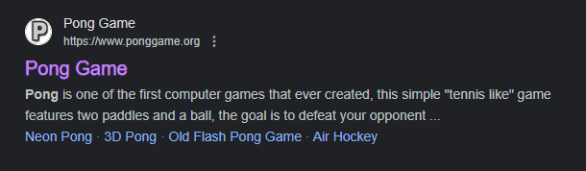
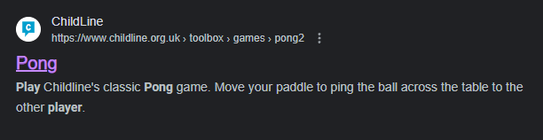

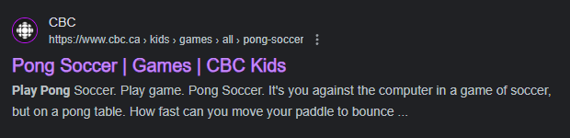
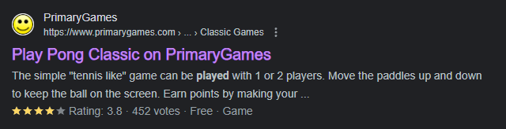
Notes:
well you can if you go on the internet and look up play pong, theres (list all of the websites, you can even play a soccer version of it) but why play on the internet when you can go to a flooded room in photonics to play on an FPGA with…

Slide 5





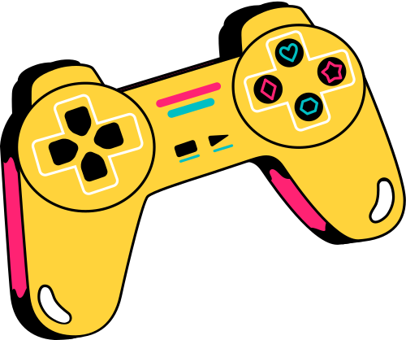

Team Bobb presents
Pong 2.0: Bounce Beyond

Slide 6



Goal /
Motivation
Create an enhanced pong experience through audio and input improvements
It’s on a keyboard!
Making multiplayer mode
multiple level designs
Adding background music

Slide 7

Goal /
Motivation
and add FPGA experience onto our resumes
Notes:
and of course, so we can put a smile on your faces, but also so we can put fpga experience on our resumes

Slide 8
Functionality
Multiplayer mode
2 players on the same keyboard
Arrow keys and WASD
Background Music
Different Music for different levels
Sound effects linked to user input
Level Design
CPU
Adding obstacles
Speeding up the ball

Slide 9

Specifications
Requirements:
VGA display
Multiplayer
Music
Constraints:
Multiple buttons being pressed at once
Acceleration for the ball
Additional:
Obstacles in the game

Slide 10
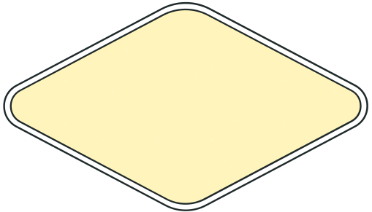
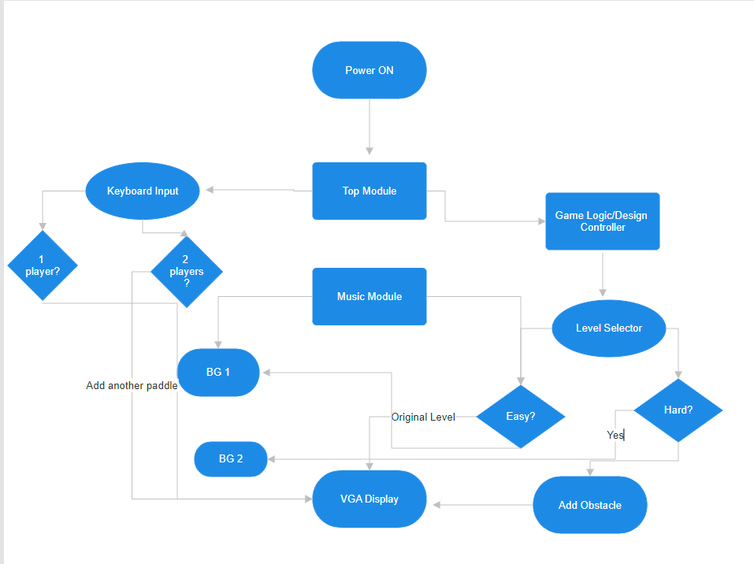
Detailed Block Diagram

Slide 11
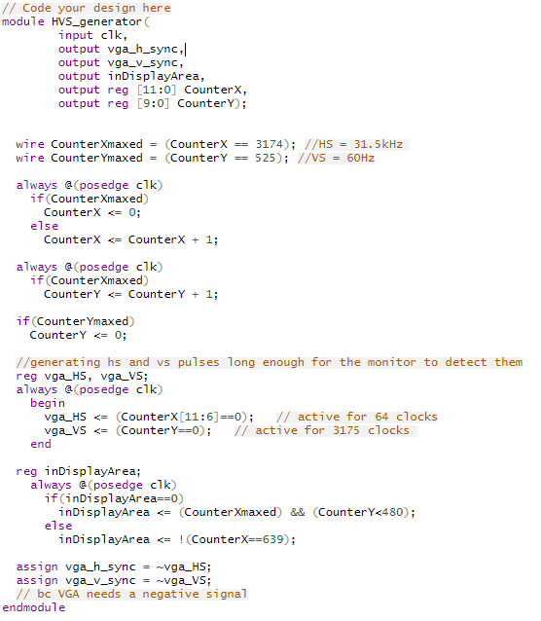

Understanding how to generate a video monitor
and make it
640x480 with 60Hz
Code Snipet

Slide 12
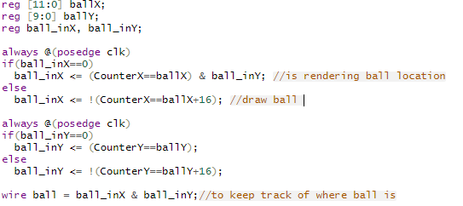
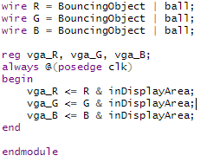
We could ‘draw’ all the objects we needed …
… where we needed
Code Snipet

Slide 13
Success
We can draw the borders, the paddles, and the ball

Slide 14
Success
We can play each other 1 v 1

Slide 15
Success
YOU CAN EVEN PLAY IT ON A KEYBOARD!

Slide 16
Notes:
just like pong

Slide 17

Failures
But not like Pong 2.0: Bounce Beyond

Slide 18
Failures
Still working on:
single player (cpu)
levels (acceleration + obstacles)
music

Slide 19
Failures
We also originally wanted to make it so multiplayer meant across multiple FPGAs,
but that’s way over our heads now

Slide 20


Thank You!
Questions?

